Slide 2
5 mins, only text, 2 runs, 128 in, 128 out
 | Mean E2E Latency (ms): | Median E2E Latency (ms): | P90 E2E Latency (ms): | P95 E2E Latency (ms): | P99 E2E Latency (ms): | Max
End-to-End Latency | 1460.60 | 1436.32 | 2587.44 | 2790.29 | 3077.29
TTFT | 71.25 | 70.58 | 85.65 | 88.78 | 97.55
TPOT | 22.13 | 22.46 | 25.13 | 25.65 | 26.36
ITL | 22.49 | 21.27 | 27.99 | 33.56 | 41.86 | 154.03
End-to-End Latency | 1390.46 | 1365.00 | 2474.06 | 2671.32 | 2945.56
TTFT | 69.54 | 69.21 | 83.98 | 88.62 | 97.25
TPOT | 21.06 | 21.45 | 24.26 | 24.82 | 25.63
ITL | 21.37 | 20.20 | 27.23 | 33.32 | 40.24 | 119.70
#Input tokens: 96823
#Output tokens: 95714
100%| 1500/1500 [05:01<00:00, 4.97it/s]
100%| 1500/1500 [05:01<00:00, 4.97it/s]
============ Serving Benchmark Result ============
Backend: sglang-oai-chat
Traffic request rate: 5.0
Max request concurrency: not set
Successful requests: 1500
Benchmark duration (s): 301.74 / 301.63
Total input tokens: 96823 / 96823
Total input text tokens: 96823 / 96823
Total generated tokens: 95714 / 95714
Total generated tokens (retokenized): 94082 / 94225
Request throughput (req/s): 4.97 / 4.97
Input token throughput (tok/s): 320.88 / 321.00
Output token throughput (tok/s): 317.20 / 317.32
Peak output token throughput (tok/s): 600.00 / 579.00
Peak concurrent requests: 24 / 24
Total token throughput (tok/s): 638.08 / 638.32
Concurrency: 7.26 / 6.91
1.3

Slide 3
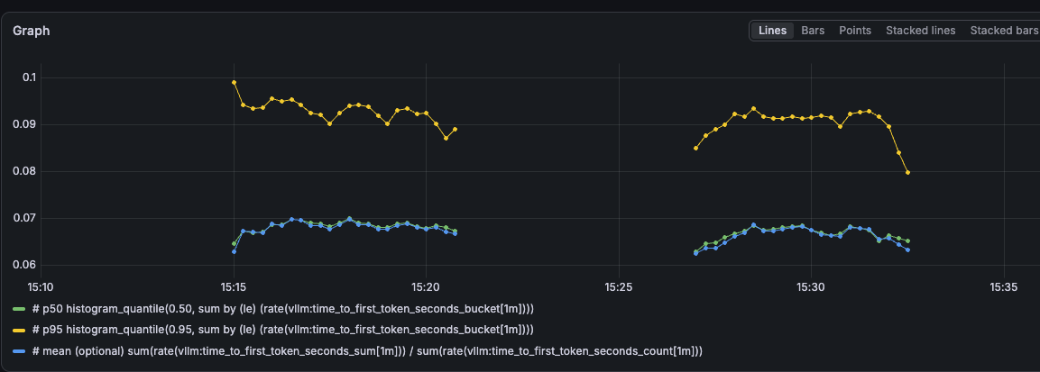
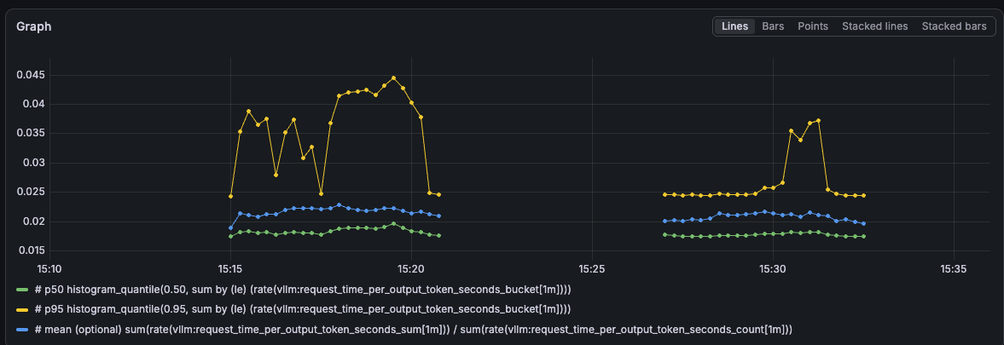
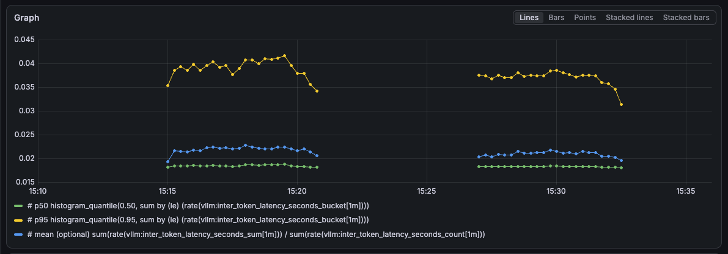
TTFT, ITL, TPOT text only

Slide 4
5 mins, inc 1 image, 1 run, 128 in, 128 out
 | Mean E2E Latency (ms): | Median E2E Latency (ms): | P90 E2E Latency (ms): | P95 E2E Latency (ms): | P99 E2E Latency (ms): | Max
End-to-End Latency | 9434.50 | 8660.17 | 17388.56 | 19220.78 | 21333.58
TTFT | 1267.52 | 1094.36 | 2368.26 | 2927.54 | 3412.26
TPOT | 136.33 | 138.13 | 191.16 | 219.38 | 314.87
ITL | 131.81 | 46.92 | 350.62 | 453.36 | 637.64 | 1694.55
End-to-End Latency
TTFT
TPOT
ITL
Created 1500 random jpeg images with average 2089831 bytes per request
100%| 1500/1500 [04:58<00:00, 5.03it/s]
============ Serving Benchmark Result ============
Backend: sglang-oai-chat
Traffic request rate: 5.0
Max request concurrency: not set
Successful requests: 1500
Benchmark duration (s): 298.35
Total input tokens: 3176989
Total input text tokens: 113989
Total input vision tokens: 3063000
Total generated tokens: 95714
Total generated tokens (retokenized): 95308
Request throughput (req/s): 5.03
Input token throughput (tok/s): 10648.61
Output token throughput (tok/s): 320.81
Peak output token throughput (tok/s): 1587.00
Peak concurrent requests: 80
Total token throughput (tok/s): 10969.42
Concurrency: 47.43

Slide 5
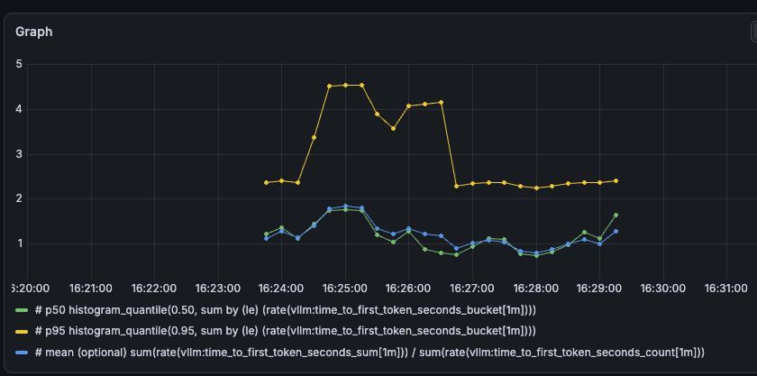
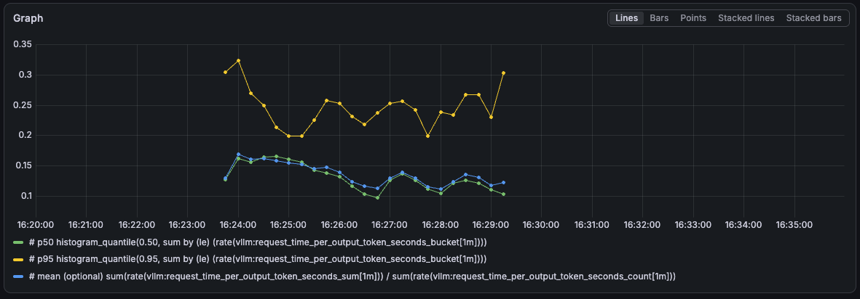
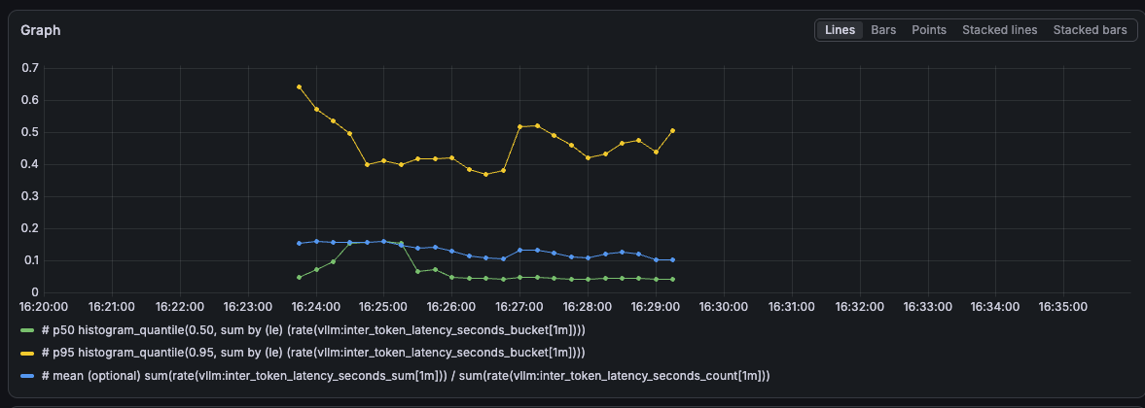
TTFT, ITL, TPOT with images

Slide 6
EPD pod
Decode
  470 – 10 sec
  331 – 15 sec
  250 – 5 sec
  185 – 20 sec
Prefill
  550 – 0.5 sec
  450 – 0.8 sec
  300 – 0.3 sec
  7 – 1 sec

Slide 7
E-PD with 1 image in request
RATES=(5)
NUM_PROMPTS=1500
IMAGE_COUNT=1
IMAGE_RESOLUTION=1080p
RANDOM_INPUT_LEN=128
RANDOM_OUTPUT_LEN=128

Slide 8
E pod
Decode
  Mostly 0.3 sec (1400)
  Some 0.5 secs (100)
E
  1500 – 0.3 sec (probably 0)

Slide 9
PD pod in e-pd configuration
Decode
  500 – 10 sec
  330 – 15 sec
  260 – 5 sec
  144 – 20 sec
  Other – lower values
Prefill
  500 – 0.5 sec
  443 – 0.8 sec
  318 – 0.3 sec
  100 – 1 sec

Slide 10
One image + long output
EPD
#Input tokens: 3177039
#Output tokens: 778850
#Total images: 1500
#Images per request: 1 (fixed)
=== Token Breakdown (per request avg / total) ===
Raw text prompt tokens (without overhead): avg=64.5, total=96823
Text prompt tokens (with chat template): avg=76.0, total=114038
Text prompt overhead: avg=11.5, total=17215
Vision tokens: avg=2042.0, total=3063001
Created 1500 random jpeg images with average 2089831 bytes per request
100%|| 1500/1500 [12:56<00:00, 1.93it/s]
E---PD
#Input tokens: 3177074
#Output tokens: 778850
#Total images: 1500
#Images per request: 1 (fixed)
=== Token Breakdown (per request avg / total) ===
Raw text prompt tokens (without overhead): avg=64.5, total=96823
Text prompt tokens (with chat template): avg=76.0, total=114074
Text prompt overhead: avg=11.5, total=17251
Vision tokens: avg=2042.0, total=3063000
Created 1500 random jpeg images with average 2089831 bytes per request
100%| 1500/1500 [13:01<00:00, 1.92it/s]
============ Serving Benchmark Result ============
Backend: sglang-oai-chat
Traffic request rate: 5.0
Max request concurrency: not set
Successful requests: 1500
Benchmark duration (s): 776.23
Total input tokens: 3177039
Total input text tokens: 114038
Total input vision tokens: 3063001
Total generated tokens: 778850
Total generated tokens (retokenized): 406266
Request throughput (req/s): 1.93
Input token throughput (tok/s): 4092.93
Output token throughput (tok/s): 1003.38
Peak output token throughput (tok/s): 1580.00
Peak concurrent requests: 949
Total token throughput (tok/s): 5096.30
Concurrency: 485.16
============ Serving Benchmark Result ============
Backend: sglang-oai-chat
Traffic request rate: 5.0
Max request concurrency: not set
Successful requests: 1500
Benchmark duration (s): 781.91
Total input tokens: 3177074
Total input text tokens: 114074
Total input vision tokens: 3063000
Total generated tokens: 778850
Total generated tokens (retokenized): 416037
Request throughput (req/s): 1.92
Input token throughput (tok/s): 4063.22
Output token throughput (tok/s): 996.09
Peak output token throughput (tok/s): 1623.00
Peak concurrent requests: 950
Total token throughput (tok/s): 5059.31
Concurrency: 483.99

Slide 11
One image + long output - cont
EPD
----------------End-to-End Latency----------------
Mean E2E Latency (ms): 251064.12
Median E2E Latency (ms): 251843.94
P90 E2E Latency (ms): 435204.21
P95 E2E Latency (ms): 461252.50
P99 E2E Latency (ms): 479046.46
---------------Time to First Token----------------
Mean TTFT (ms): 225988.02
Median TTFT (ms): 228047.39
P90 TTFT (ms): 412238.25
P95 TTFT (ms): 430708.87
P99 TTFT (ms): 455903.40
-----Time per Output Token (excl. 1st token)------
Mean TPOT (ms): 49.15
Median TPOT (ms): 48.76
P90 TPOT (ms): 52.61
P95 TPOT (ms): 55.12
P99 TPOT (ms): 66.68
---------------Inter-Token Latency----------------
Mean ITL (ms): 66.38
Median ITL (ms): 35.86
P90 ITL (ms): 166.65
P95 ITL (ms): 200.60
P99 ITL (ms): 378.13
Max ITL (ms): 3404.02
E---PD
----------------End-to-End Latency----------------
Mean E2E Latency (ms): 252290.88
Median E2E Latency (ms): 253472.78
P90 E2E Latency (ms): 437618.75
P95 E2E Latency (ms): 463490.56
P99 E2E Latency (ms): 484957.18
---------------Time to First Token----------------
Mean TTFT (ms): 227359.01
Median TTFT (ms): 229192.09
P90 TTFT (ms): 414535.67
P95 TTFT (ms): 434479.54
P99 TTFT (ms): 458551.31
-----Time per Output Token (excl. 1st token)------
Mean TPOT (ms): 49.00
Median TPOT (ms): 48.46
P90 TPOT (ms): 52.61
P95 TPOT (ms): 55.17
P99 TPOT (ms): 76.37
---------------Inter-Token Latency----------------
Mean ITL (ms): 65.42
Median ITL (ms): 36.58
P90 ITL (ms): 162.09
P95 ITL (ms): 190.52
P99 ITL (ms): 364.13
Max ITL (ms): 2710.93

Slide 12
Processing times
EPD
  Decode
    300 – 50 sec
    280 – 40 sec
    275 – 30 sec
    175 – 20 sec
    150 – 15 sec
    146 – 10 sec
  Prefill
    972 – 0.3 sec
    405 – 0.5 sec
    90 – 0.8 sec
E---PD
  Decode
    470 – 10 sec
    331 – 15 sec
    250 – 5 sec
    185 – 20 sec
  Prefill
    550 – 0.5 sec
    450 – 0.8 sec
    300 – 0.3 sec
    7 – 1 sec

Slide 13
New config
E – try to run with tp=1
PD – run with tp=4
Check logs (e & PD ) that encoded images are transferred from e to d

Slide 14
19-07

Slide 15
Rate 20, images 8 (use hard coded)
[Sun Jul 19 08:16:09 AM UTC 2026] Waiting for http://aggregation-epp:80/v1/models ...
Endpoint up.
[Sun Jul 19 08:16:09 AM UTC 2026] === Rate 20 ===
/usr/local/lib/python3.12/dist-packages/torchao/quantization/quant_api.py:1731: SyntaxWarning: invalid escape sequence '\.'
"""Configuration class for applying different quantization configs to modules or parameters based on their fully qualified names (FQNs).
/sgl-workspace/sglang/python/sglang/srt/layers/attention/fla/utils.py:223: UserWarning: Triton is not supported on current platform, roll back to CPU.
warnings.warn(
Warning: You are sending unauthenticated requests to the HF Hub. Please set a HF_TOKEN to enable higher rate limits and faster downloads.
benchmark_args=Namespace(backend='sglang-oai-chat', base_url=None, host='aggregation-epp', port=80, ready_check_timeout_sec=60, dataset_name='random', dataset_path='', speed_bench_category=None, speed_bench_output_len=512, model='Qwen/Qwen3-VL-235B-A22B-Instruct-FP8', served_model_name=None, tokenizer=None, num_prompts=1200, sharegpt_output_len=None, sharegpt_context_len=None, random_input_len=128, random_output_len=128, random_range_ratio=1.0, image_count=8, image_resolution='1080p', random_image_count=False, image_format='jpeg', image_content='random', request_rate=20.0, use_trace_timestamps=False, max_concurrency=None, output_file=None, output_details=False, print_requests=False, disable_tqdm=False, disable_stream=False, return_logprob=False, top_logprobs_num=0, token_ids_logprob=None, logprob_start_len=-1, return_routed_experts=False, cache_report=False, seed=42, disable_ignore_eos=False, temperature=0.0, top_p=1.0, extra_request_body='{"ignore_eos": true}', apply_chat_template=False, profile=False, plot_throughput=False, profile_activities=['CPU', 'GPU'], profile_start_step=None, profile_steps=None, profile_num_steps=None, profile_by_stage=False, profile_stages=None, profile_output_dir=None, profile_prefix=None, lora_name=None, lora_request_distribution='uniform', lora_zipf_alpha=1.5, prompt_suffix='', pd_separated=False, profile_prefill_url=None, profile_decode_url=None, flush_cache=False, warmup_requests=1, tokenize_prompt=False, gsp_num_groups=64, gsp_prompts_per_group=16, gsp_system_prompt_len=2048, gsp_question_len=128, gsp_output_len=256, gsp_range_ratio=1.0, gsp_fast_prepare=False, gsp_send_routing_key=False, gsp_num_turns=1, gsp_ordered=False, gsp_group_distribution='uniform', gsp_zipf_alpha=None, mooncake_slowdown_factor=1.0, mooncake_num_rounds=1, mooncake_workload='conversation', fake_prefill=False, tag=None, header=None)
Waiting up to 60s for http://aggregation-epp:80/v1/models to become ready...
Server ready in 0.0s.
Namespace(backend='sglang-oai-chat', base_url=None, host='aggregation-epp', port=80, ready_check_timeout_sec=60, dataset_name='random', dataset_path='', speed_bench_category=None, speed_bench_output_len=512, model='Qwen/Qwen3-VL-235B-A22B-Instruct-FP8', served_model_name=None, tokenizer=None, num_prompts=1200, sharegpt_output_len=None, sharegpt_context_len=None, random_input_len=128, random_output_len=128, random_range_ratio=1.0, image_count=8, image_resolution='1080p', random_image_count=False, image_format='jpeg', image_content='random', request_rate=20.0, use_trace_timestamps=False, max_concurrency=None, output_file=None, output_details=False, print_requests=False, disable_tqdm=False, disable_stream=False, return_logprob=False, top_logprobs_num=0, token_ids_logprob=None, logprob_start_len=-1, return_routed_experts=False, cache_report=False, seed=42, disable_ignore_eos=False, temperature=0.0, top_p=1.0, extra_request_body='{"ignore_eos": true}', apply_chat_template=False, profile=False, plot_throughput=False, profile_activities=['CPU', 'GPU'], profile_start_step=None, profile_steps=None, profile_num_steps=None, profile_by_stage=False, profile_stages=None, profile_output_dir=None, profile_prefix=None, lora_name=None, lora_request_distribution='uniform', lora_zipf_alpha=1.5, prompt_suffix='', pd_separated=False, profile_prefill_url=None, profile_decode_url=None, flush_cache=False, warmup_requests=1, tokenize_prompt=False, gsp_num_groups=64, gsp_prompts_per_group=16, gsp_system_prompt_len=2048, gsp_question_len=128, gsp_output_len=256, gsp_range_ratio=1.0, gsp_fast_prepare=False, gsp_send_routing_key=False, gsp_num_turns=1, gsp_ordered=False, gsp_group_distribution='uniform', gsp_zipf_alpha=None, mooncake_slowdown_factor=1.0, mooncake_num_rounds=1, mooncake_workload='conversation', fake_prefill=False, tag=None, header=None)
#Input tokens: 153600
#Output tokens: 153600
Starting warmup with 1 sequences...
Warmup completed with 1 sequences. Starting main benchmark run...
100%|██████████| 1200/1200 [01:03<00:00, 18.82it/s]
============ Serving Benchmark Result ============
Backend: sglang-oai-chat
Traffic request rate: 20.0
Max request concurrency: not set
Successful requests: 1200
Benchmark duration (s): 63.77
Total input tokens: 153600
Total input text tokens: 153600
Total generated tokens: 153600
Total generated tokens (retokenized): 151574
Request throughput (req/s): 18.82
Input token throughput (tok/s): 2408.59
Output token throughput (tok/s): 2408.59
Peak output token throughput (tok/s): 3148.00
Peak concurrent requests: 111
Total token throughput (tok/s): 4817.18
Concurrency: 62.30
----------------End-to-End Latency----------------
Mean E2E Latency (ms): 3310.60
Median E2E Latency (ms): 3330.96
P90 E2E Latency (ms): 3453.84
P95 E2E Latency (ms): 3463.44
P99 E2E Latency (ms): 3483.76
---------------Time to First Token----------------
Mean TTFT (ms): 72.65
Median TTFT (ms): 73.02
P90 TTFT (ms): 83.38
P95 TTFT (ms): 85.15
P99 TTFT (ms): 89.21
-----Time per Output Token (excl. 1st token)------
Mean TPOT (ms): 25.50
Median TPOT (ms): 25.67
P90 TPOT (ms): 26.59
P95 TPOT (ms): 26.63
P99 TPOT (ms): 26.83
---------------Inter-Token Latency----------------
Mean ITL (ms): 25.86
Median ITL (ms): 25.67
P90 ITL (ms): 27.06
P95 ITL (ms): 27.53
P99 ITL (ms): 30.98
Max ITL (ms): 133.99
==================================================
[Sun Jul 19 08:17:35 AM UTC 2026] Rate 20 done.
[Sun Jul 19 08:17:35 AM UTC 2026] All rates complete.

Slide 16
vllm:request_decode_time_seconds_bucket{engine="0",le="0.3",model_name="Qwen/Qwen3-VL-235B-A22B-Instruct-FP8"} 0.0
vllm:request_decode_time_seconds_bucket{engine="0",le="0.5",model_name="Qwen/Qwen3-VL-235B-A22B-Instruct-FP8"} 2.0
vllm:request_decode_time_seconds_bucket{engine="0",le="0.8",model_name="Qwen/Qwen3-VL-235B-A22B-Instruct-FP8"} 3.0
vllm:request_decode_time_seconds_bucket{engine="0",le="1.0",model_name="Qwen/Qwen3-VL-235B-A22B-Instruct-FP8"} 3.0
vllm:request_decode_time_seconds_bucket{engine="0",le="1.5",model_name="Qwen/Qwen3-VL-235B-A22B-Instruct-FP8"} 3.0
vllm:request_decode_time_seconds_bucket{engine="0",le="2.0",model_name="Qwen/Qwen3-VL-235B-A22B-Instruct-FP8"} 10.0
vllm:request_decode_time_seconds_bucket{engine="0",le="2.5",model_name="Qwen/Qwen3-VL-235B-A22B-Instruct-FP8"} 113.0
vllm:request_decode_time_seconds_bucket{engine="0",le="5.0",model_name="Qwen/Qwen3-VL-235B-A22B-Instruct-FP8"} 2735.0
vllm:request_decode_time_seconds_bucket{engine="0",le="10.0",model_name="Qwen/Qwen3-VL-235B-A22B-Instruct-FP8"} 2811.0
vllm:request_decode_time_seconds_count{engine="0",model_name="Qwen/Qwen3-VL-235B-A22B-Instruct-FP8"} 2811.0
vllm:request_decode_time_seconds_sum{engine="0",model_name="Qwen/Qwen3-VL-235B-A22B-Instruct-FP8"} 9922.541681243107
vllm:request_prefill_time_seconds_bucket{engine="0",le="0.3",model_name="Qwen/Qwen3-VL-235B-A22B-Instruct-FP8"} 2789.0
vllm:request_prefill_time_seconds_bucket{engine="0",le="0.5",model_name="Qwen/Qwen3-VL-235B-A22B-Instruct-FP8"} 2789.0
vllm:request_prefill_time_seconds_bucket{engine="0",le="0.8",model_name="Qwen/Qwen3-VL-235B-A22B-Instruct-FP8"} 2790.0
vllm:request_prefill_time_seconds_bucket{engine="0",le="1.0",model_name="Qwen/Qwen3-VL-235B-A22B-Instruct-FP8"} 2811.0
vllm:request_prefill_time_seconds_bucket{engine="0",le="1.5",model_name="Qwen/Qwen3-VL-235B-A22B-Instruct-FP8"} 2811.0
vllm:request_prefill_time_seconds_count{engine="0",model_name="Qwen/Qwen3-VL-235B-A22B-Instruct-FP8"} 2811.0
vllm:request_prefill_time_seconds_sum{engine="0",model_name="Qwen/Qwen3-VL-235B-A22B-Instruct-FP8"} 182.50267336331308

Slide 17
20-07-2026

Slide 18
NEW Sidecar | Mean | Med | P90 | P99
E2e latency | 25315 | 23980 | 40366 | 41404
TTFT | 20186 | 19223 | 35017 | 37362
TPOT | 40.39 | 40.54 | 44.84 | 50.37
ITL | 41.21 | 25.03 | 71.92 | 138.10
Processing time | 01:41
Rate 20
1 min
OLD Sidecar | Mean | Med | P90 | P99
E2e latency | 5903 | 5979 | 6756 | 7050
TTFT | 186 | 163 | 264 | 431
TPOT | 45 | 45 | 51 | 53
ITL | 45 | 39 | 78 | 145
Processing time | 01:04
Rate 20
1 min
NEW Sidecar | Mean | Med | P90 | P99
E2e latency | 24419 | 23066 | 39950 | 41635
TTFT | 20170 | 19000 | 35627 | 38457
TPOT | 33.46 | 33.39 | 35.58 | 40.00
ITL | 34.15 | 25.68 | 49.62 | 72.14
Processing time | 01:42
Rate 20
1 min
OLD Sidecar | Mean | Med | P90 | P99
E2e latency | 6022 | 6023 | 6987 | 7410
TTFT | 195 | 166 | 273 | 665
TPOT | 45 | 46 | 53 | 56
ITL | 46 | 40 | 79 | 148
Processing time | 01:04
Rate 20
1 min

Slide 19
TTFT
Sidecar versions
  Request: 1 img 1080p, 128 tokens in, 128 tokens out
    Llmd-0.9.0 – 0.2s
    Alexey PR – 20s
    Main built by Alexey – 20s
    Main from llmd – 18s
  Request: 128 tokens in, 128 tokens out, no images
    Main from llmd – 0.1s

